Slide 1
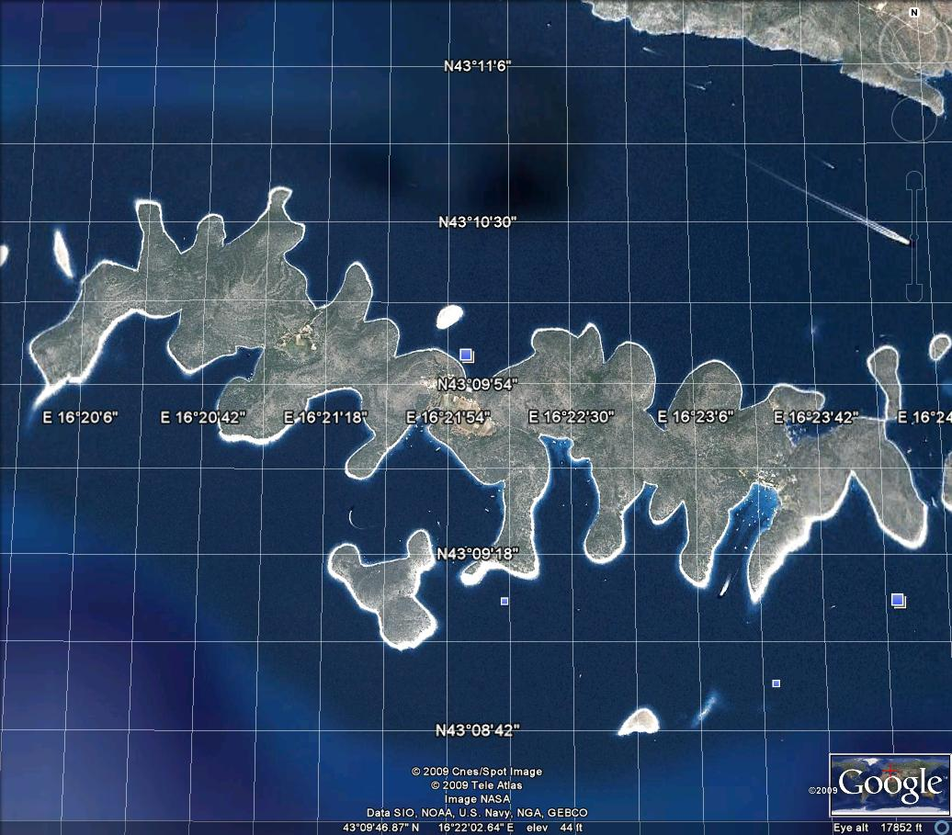
SOLINE

Slide 2
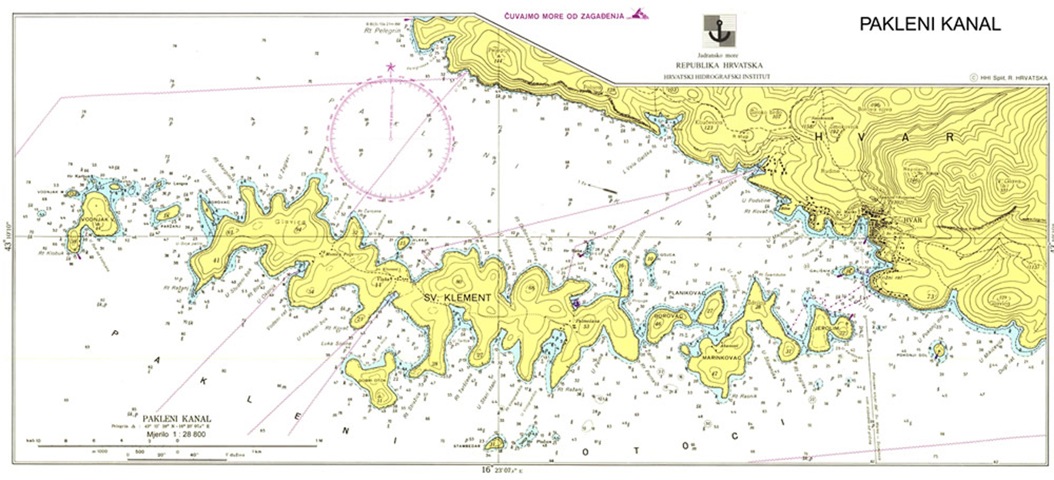

Slide 3
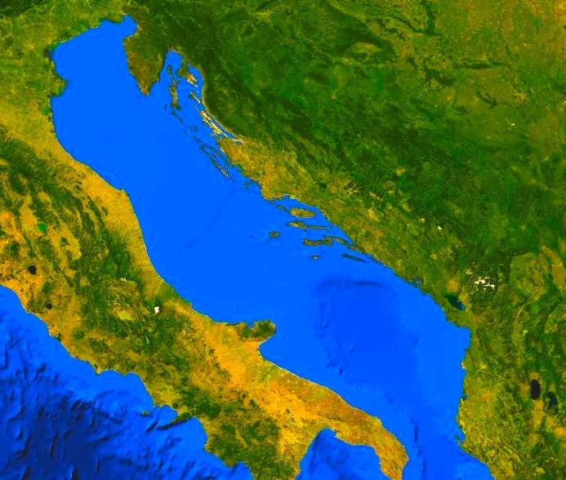

Slide 4
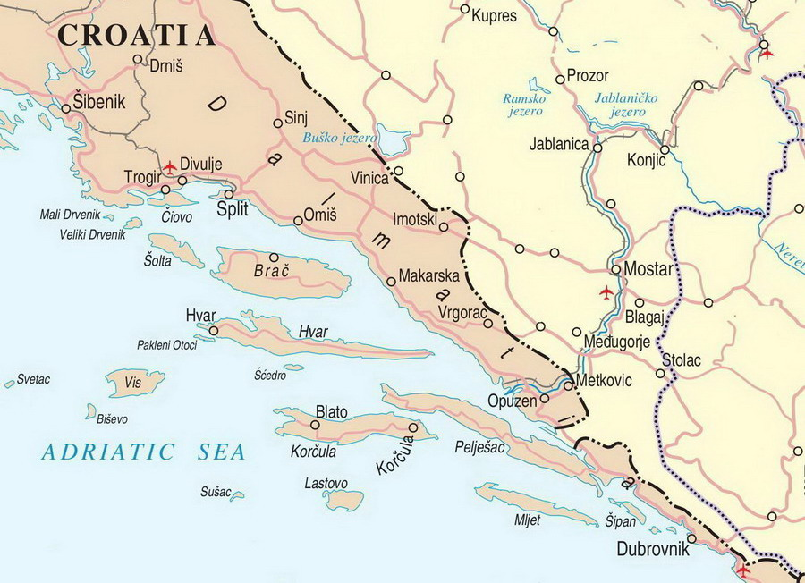

Slide 5
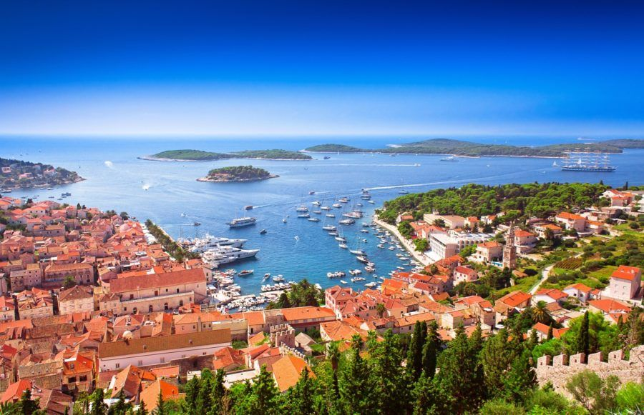
FOREGROUND: HVAR CITY
BACKGROUND: PAKLENI ISLANDS, SV. KLEMENT (right)

Slide 6
